Slide 1
Glass Classification using KNN
Group 27
Shruti Houji – 405203
Rhishabh Hattarki – 405204
Sahil Dixit – 405205
Sanika Patil – 405206

Slide 2
LP - 2 Part A: Data Mining
ASSIGNMENTS:
Write Java/Python code for simple implementation of K-means clustering algorithm.
Implement Apriori approach for data mining to organize data items on shelf using given table using Java/Python.
Implement Naive Bayes for concurrent application. Approach should handle categorical and continuous data using Java/Python.
Consider a suitable text dataset. Remove stop words, apply stemming and feature selection techniques to represent documents as vectors.

Slide 3
Write Java/Python code for simple implementation of K-means clustering algorithm.
Link to K-means clustering

Slide 4
Implement Apriori approach for data mining to organize data items on shelf using given table using Java/Python.
Link to Apriori approach

Slide 5
Implement Naive Bayes for concurrent application. Approach should handle categorical and continuous data using Java/Python.
Link to Naïve Bayes

Slide 6
Consider a suitable text dataset. Remove stopwords, apply stemming and feature selection techniques to represent documents as vectors.
Link to stopwords

Slide 7
LP - 2 Part B: Software Testing and Quality Assurance
ASSIGNMENTS:
To study different types of software testing techniques with reference to software testing and quality assurance
To study and perform Unit Testing using testing tool JUnit.
Study and implementation of integration testing for implementation of software project in python/java
To study web based testing using Selenium.

Slide 8
To study different types of software testing techniques with reference to software testing and quality assurance
Link to testing techniques

Slide 9
To study and perform Unit Testing using testing tool PYtest.
Link to pytest

Slide 10
Study and implementation of integration testing for implementation of software project in python/java
Link to integration testing

Slide 11
To study web based testing using Selenium.
Link to selenium testing

Slide 12
GLASS CLASSIFICATION USING KNN

Slide 13
PROBLEM DEFINITION
To design and implement a system that will predict the application of the glass if the properties of the glass is given as input.

Slide 14
INTRODUCTION
There are different industries that need to classify the type of glass based on its properties, such as refractive index and its constituent elements such as Sodium(Na), Magnesium(Mg) etc.
Based on all these properties, the function of that glass is to be decided, such as vehicular windows, containers, table ware etc.
We are using Machine learning models like KNN(K Nearest Neighbours) and K-means to analyze the data and gives the properties appropriately predict which application it would be suitable for.

Slide 15
SCOPE STATEMENT
KNN has been used for classification and K-means has been used for clustering.
A machine learning model is trained to predict the type of glass.
A user friendly GUI is developed for entering the values.

Slide 16
Idea matrix ‘I’
IDEA | Deliverable | Parameter Affected
Increase | It increases Glass Quality | Glass Contents
Improve | It improves the identification of glass type Improves awareness of customer about glass type | Chemical Contents User awareness
Ignore | It ignores the physical appearance of the glass. | No parameter is affected.

Slide 17
IDEA | Deliverable | Parameter Affected
Deliver | It delivers specific class types to specific customers | Customers
Document | Documentation of the project for researchers to understand and improve on the project in the future. | Project documentation
Decrease | It decreases efforts and time taken to classify the types | Effort
Idea matrix
‘D’

Slide 18
IDEA | Deliverable | Parameter Affected
Educate | Educate user with knowledge of type of glass Educate project members with –machine learning(knn, kmeans), selenium, pytest | User Project members
Evaluate | Evaluate weight percent in corresponding oxide from user to classify type of glass. Evaluate efficiency of algorithms to create the best model | User Input, output Efficiency of algorithms
Experiment | Experiment on different types of ML models Experiment on different distance metrics like Euclidean, Manhatten, Minkowski | ML models Distance Metrics
Idea matrix
‘E’

Slide 19
IDEA | Deliverable | Parameter Affected
Accelerate | Accelerates the process of classifying the glasses according to its properties | Execution speed of the process in the factory/company
Analysis | It analyses the data using K-means clustering and forms a visual representation of the clusters. | Understanding and knowledge of the dataset
Actualize | Implementation of the system using the dataset | Project model
Idea matrix
‘A’

Slide 20
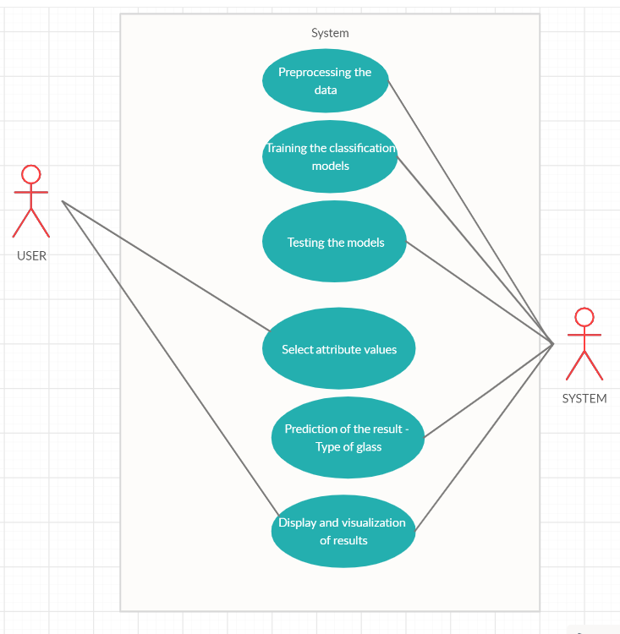
USE CASE DIAGRAM

Slide 21
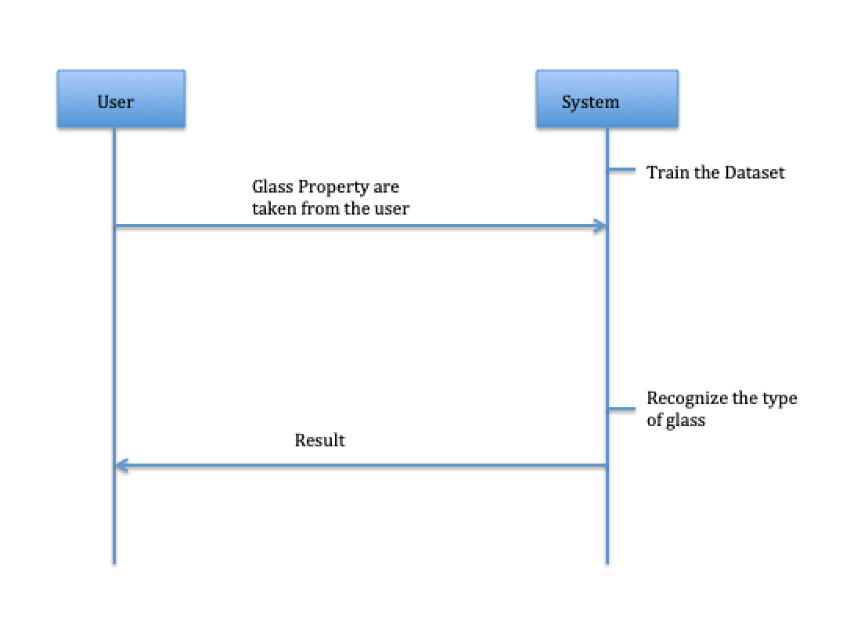
SEQUENCE DIAGRAM

Slide 22
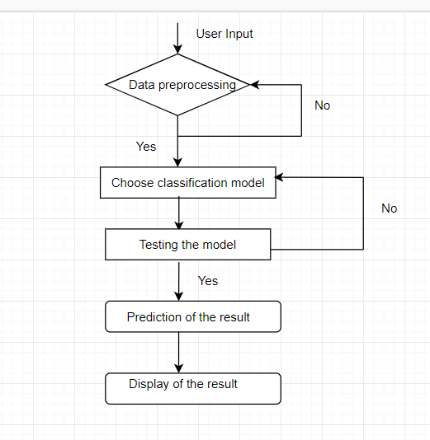
ACTIVITY DIAGRAM

Slide 23
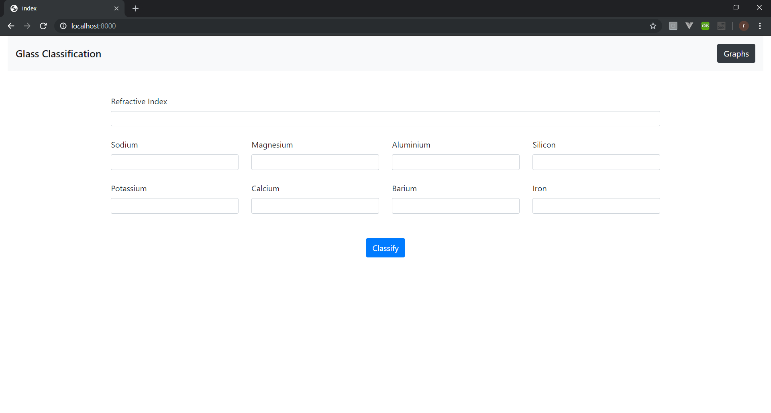
GUI
Homepage
Before filling values

Slide 24
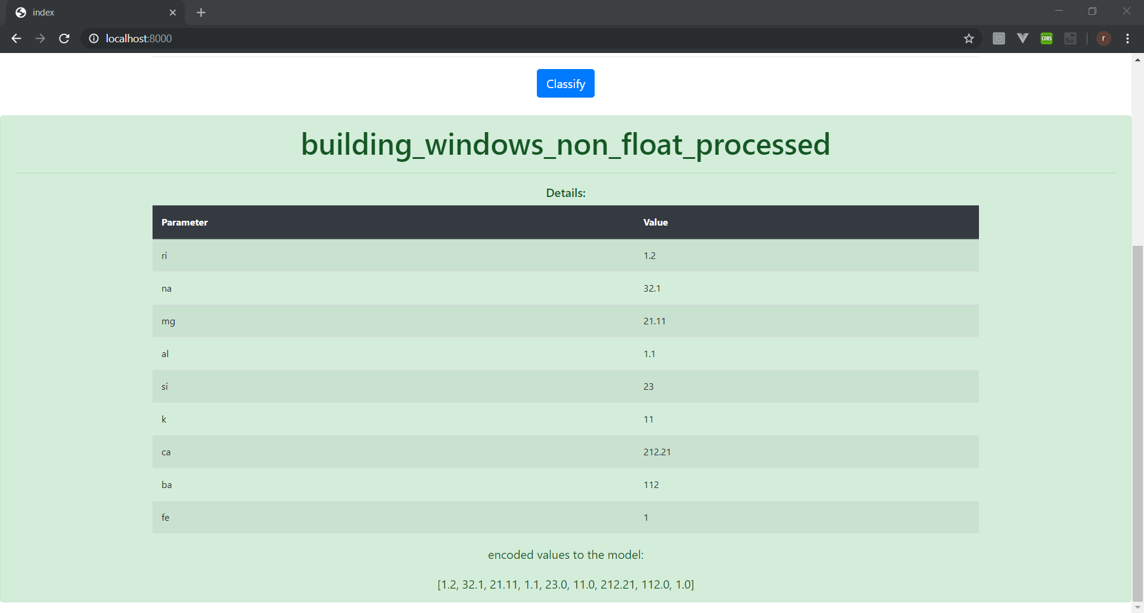
GUI
Homepage
Report
After classification

Slide 25
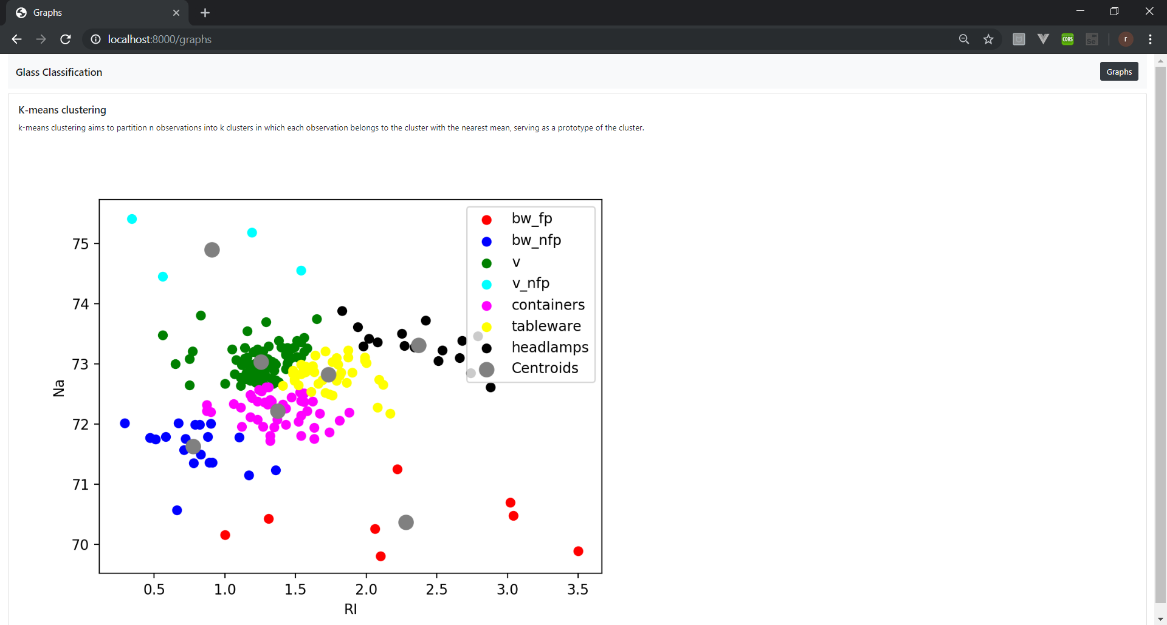
Clustering
partition n observations into
k clusters in which each
observation belongs to the
cluster with the nearest mean,
serving as a prototype of the
Cluster.

Slide 26
Conclusion
We have created a system that can take input from the user about various attributes which are basically properties of the glass. These readings are then successfully classified according to the various categories of the glass.
Testing is performed which makes sure that the expected and actual results are a match for every single module. Different types such as unit testing, functional testing etc are performed to make the project detect free.
As a concluding point, given the values of the attributes, the algorithm has been trained to correctly predict the type of glass.
.

